Slide 1
Citrus Biosecurity
Lesson 2 | Insect Food Webs

Slide 2
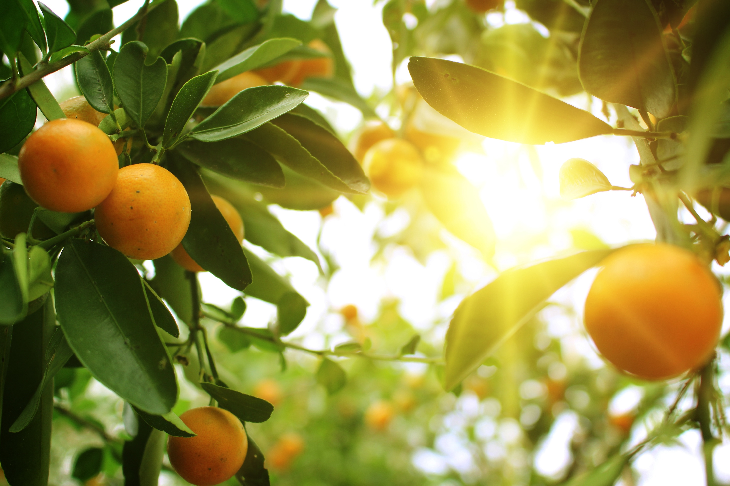
Food Webs
Crops

Slide 3
Pest or Beneficial?
Crops
Locusts
Snails
Thrips
Praying mantis
Pests damage crops and cost growers money

Slide 4
Pest or Beneficial?
Crops
Thrips
Praying mantis
Locusts
Snails
Lizards
Birds
Worms
Ladybug
Snakes
Beneficial insects eat crop predators and save growers money
Pests damage crops and cost growers money

